Slide 1
project Name “FOOD ORDERING” BY DWARAPUDI RAMAPRASAD ELECTRONICS AND COMMUNICATION ENGINEERING DEPT. NATIONAL INSTITUTE OF TECHNOLOGY, SILCHAR In the fulfillment for the internship in WEB DEVELOPMENT

Slide 2
Introduction: A food ordering project in web development involves creating a website or web application that enables users to browse menus, place food orders, and interact with restaurants or food service providers online. It combines user-friendly interfaces, secure payment processing, and efficient order management systems to provide a seamless and convenient food ordering experience.

Slide 3


Slide 4
Existing Method
This method involved developing multiple sets of HTML, CSS, and JavaScript files, each optimized for a particular device category. For instance, a desktop version of the website would feature a more elaborate layout with larger text and graphics, while the mobile version would prioritize simplicity and ease of navigation.
Maintaining multiple versions of a website, however, posed several significant drawbacks. First and foremost, it required duplicating efforts in terms of design, development, and maintenance

Slide 5
Proposed Method with Architecture:
In response to the challenges posed by the traditional approach and inspired by the principles of responsive web design, a new method is proposed for creating a multipage responsive website using flexbox as the core layout model. This method combines the power of flexbox with modular design principles to achieve a scalable and adaptable architecture.

Slide 6
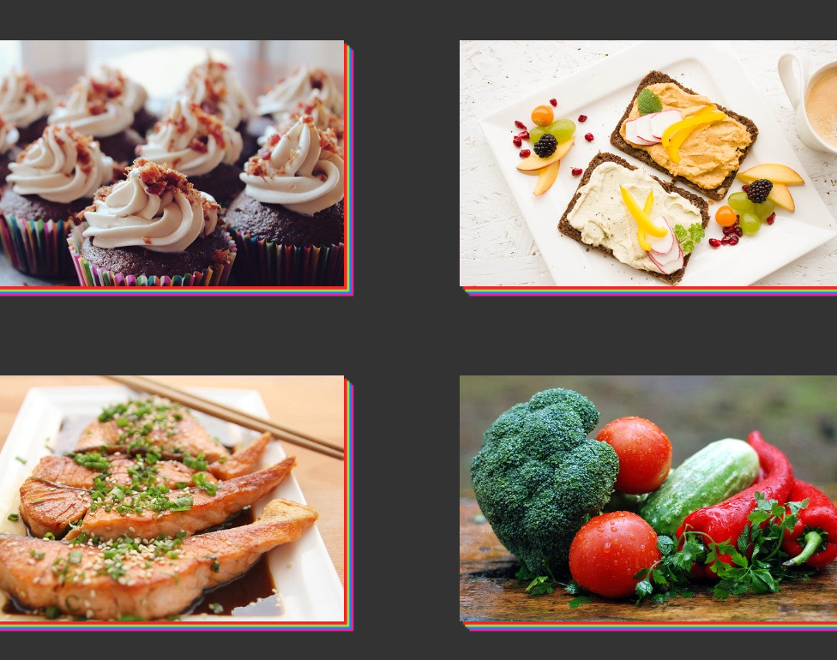
HTML Structure: The website follows a standard HTML5 structure, with the main content divided into sections and nested elements.
CSS Styling: To achieve the desired responsive layout, a combination of CSS rules and stylesheets are employed.
Navigation and Routing: A navigation system is implemented to allow users to seamlessly navigate between different pages of the website. This can be achieved through traditional navigation menus, hamburger menus for mobile devices, or other intuitive user interface elements

Slide 7
ADVANTAGES OF PROPOSED METHOD :
Increased Convenience.
Enhanced Customer Experience.
Expanded Customer Reach.
Improved Order Accuracy.
Efficient Order Management.
Data Analysis and Insights.
Integration with Third-Party Services.
Cost Savings.

Slide 8
Design and Wireframing : Once the requirements were clear, the design and wireframing phase commenced. Wireframes and mockups were created to visualize the layout and structure of each webpage. Attention was given to user experience, visual aesthetics, and the responsive behavior of the website across different devices and screen sizes.
Front-end Development: The front-end development phase involved the actual implementation of the design using HTML, CSS, and JavaScript. The responsive layout was achieved using Flexbox, which allowed for flexible and dynamic page structures. Three different stylesheets were created, one for each page (index, services, and contact), to maintain consistency and adaptability.

Slide 9
Implementation:
The implementation phase of the project involved the practical execution of the proposed method and the development of a multipage responsive website using the Flexbox layout model. This section provides a detailed account of the specific steps and procedures followed during the implementation phase, highlighting the tools, technologies, and techniques employed.
Technology Selection
Development Environment Setup
Page Structure and Layout
Styling with CSS
Interactivity with JavaScript

Slide 10
THANK YOU.

